Slide 8
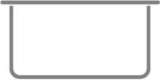
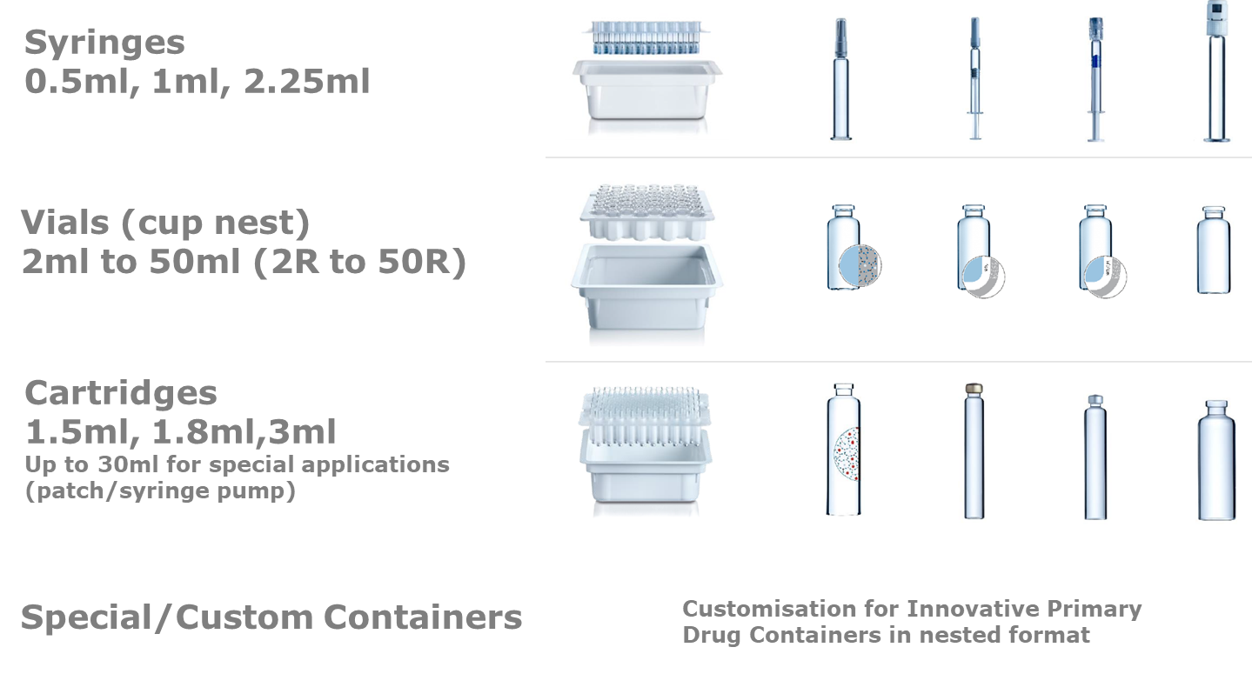
RTU PRODUCT RANGE
RTU
3P INNOVATION
SYRINGES
0.5ml, 1ml, 2.25ml
VIALS (CUP NEST)
2ml to 50ml (2R to 50R)
CARTRIDGES
1.5ml, 1.8ml,3ml
Up to 30ml for special applications (patch/syringe pump)
ROBOFIL™
CUSTOM CONTAINERS
Customisation for Innovative Primary Drug Containers in nested format

Slide 9
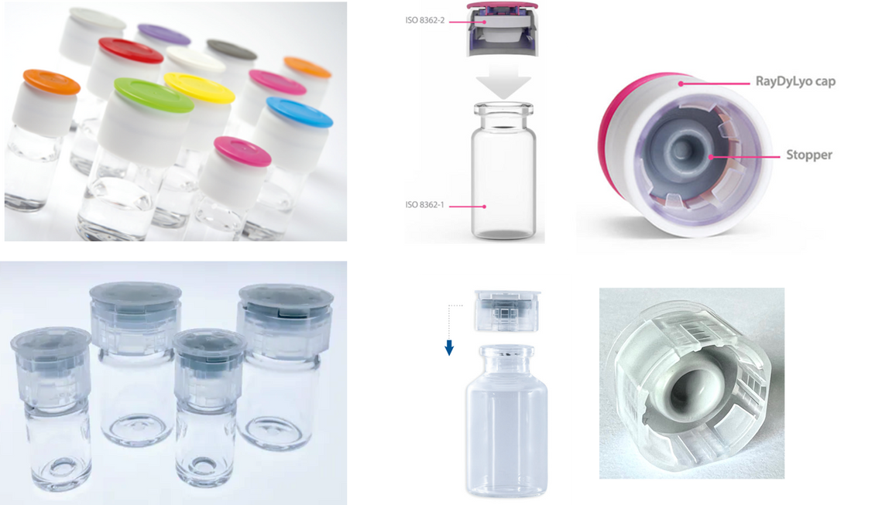


VIAL PRESS FIT CLOSURES
RTU
3P INNOVATION
13mm & 20mm
RAYDYLYO
PLASCAP
ROBOFIL™

Slide 10
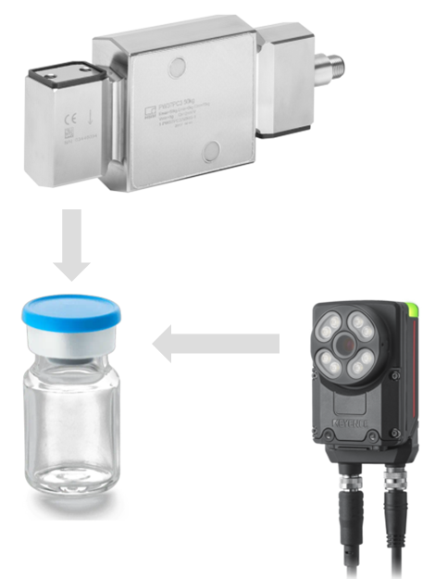
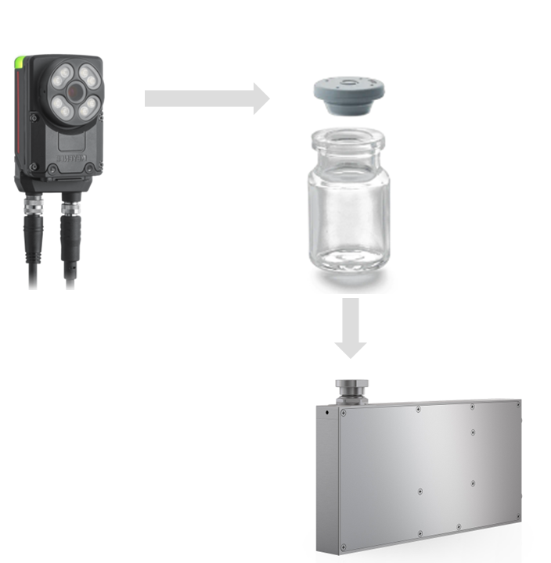
PRODUCT QUALITY CONTROL
3P INNOVATION
Individualisation of containers (removal from the nest) + 100% IPC and Reject Management
Load Cell
  Pre-crimp load
  Inferred
  Residual Seal Force
Weigh cell
  Vial present (No vial-No fill)
  Liquid net weight
  Pump Feedback (Zero-loss prime/filling)
Vision System + AI
  Stopper present
  Stopper Position/height
Vision System + AI
  Cap present
  Crimp Quality
ROBOFIL™

Slide 11

3P INNOVATION
ANNEX 1 COMPLIANT
Engineered from the ground up following the latest Annex 1 revision.
Ex-MHRA Inspector consulted and involved in the specification and design
First Air principle fully adopted
0.45 m/s Unidirectional Airflow at working position
Environmental Monitoring risk-based approach – Passive settle plates, Active Air samplers and Particle Counters
With 100% level of quality inspection and advanced reject management, roboFIL™ minimises contamination, supporting a robust Contamination Control Strategy (CCS).
ROBOFIL™

Slide 12

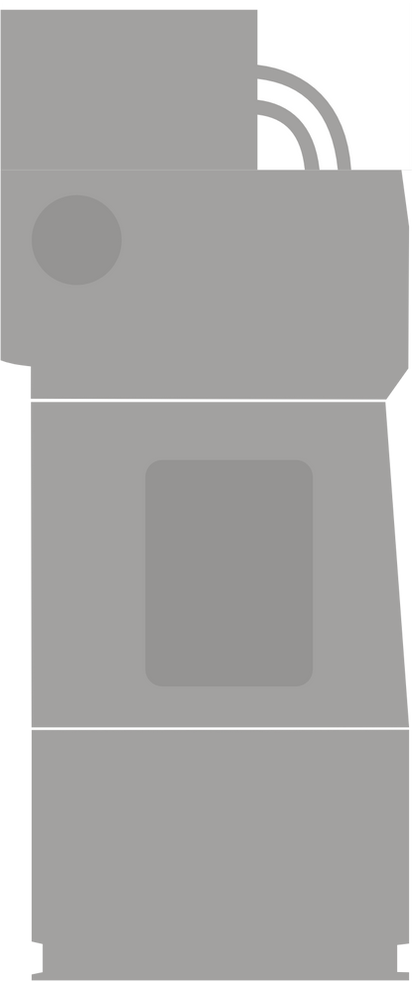
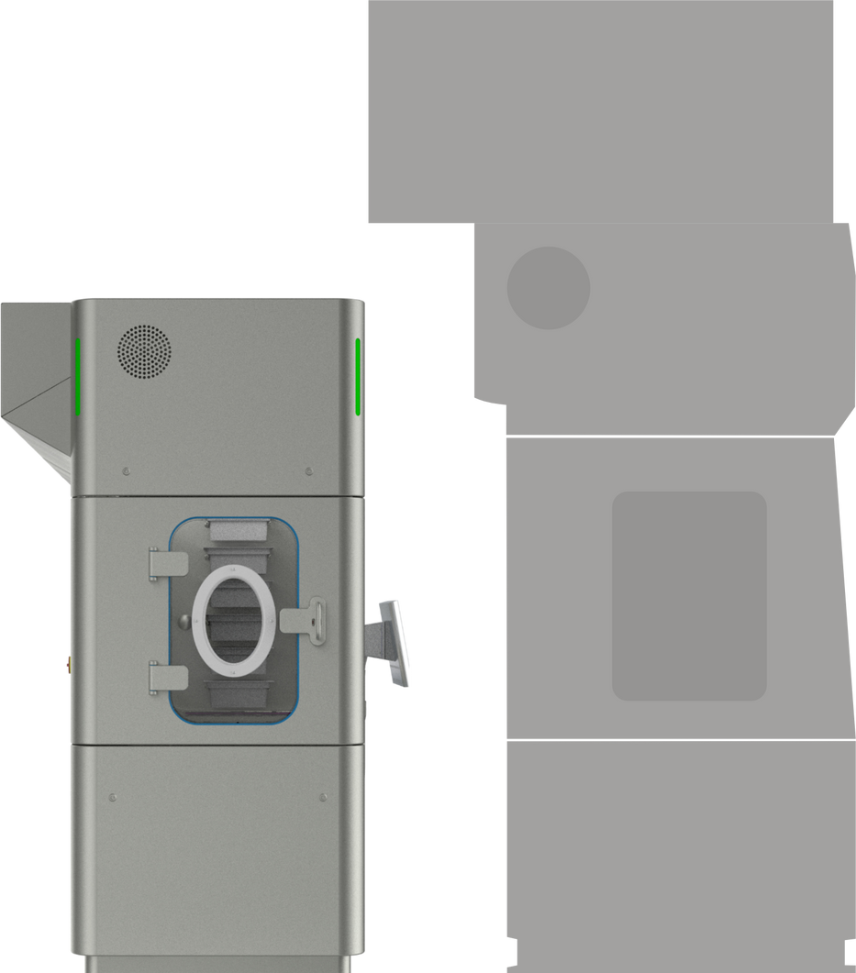

PLUG & PLAY
3P INNOVATION
Compact design fits seamlessly into existing clean rooms, with minimal integration.
Integrated,
Bag Removal
Air handling
VPHP Generator and Catalysts
Electrical Cabinets
Environmental Monitoring
Vial Crimping (if required)
Single source supply = simplified integration, commissioning and service
ROBOFIL™
Industry standard
Floor-to-ceiling design
Built into clean room
2450mm

Slide 13
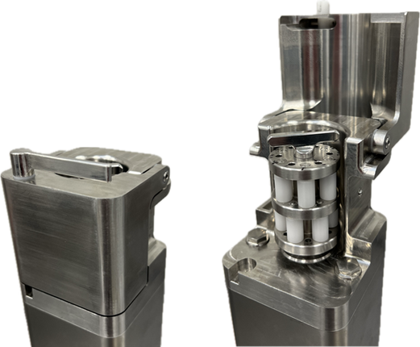

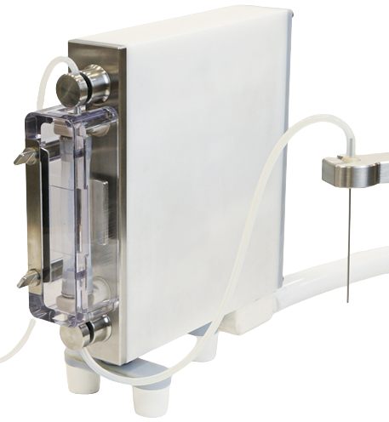
3P INNOVATION
PERISTALTIC PUMP
  High accuracy filling <1%
  0.1ml to 50ml+
  Fully stainless construction
  Compact, clean design
LIQUID PUMP TECHNOLOGIES SINGLE USE FLUID PATH
LINISTALTIC™ PUMP
  Novel principle (Patent pending)
  High accuracy filling (0.1 to 5ml)
  Suitable for high viscocity and shear sensitive products including ATMP’s
  Eliminates the need for Rotary Piston Pumps
roboFIL™ utilises 3P innovation’s existing liquid filling technology.
ROBOFIL™

Slide 14
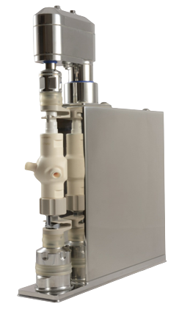
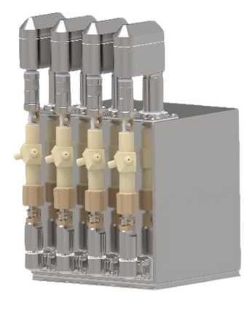
3P INNOVATION
ROTARY PISTON PUMP (NEOCERAM)
LIQUID PUMP TECHNOLOGIES
ROTARY PISTON PUMP
  Each pump is servo controlled for individual control and adjustment
  Precision filling from as low as 0.05 ml
  Accuracies of better than +/-0.2%
  Suitable for viscous products
  Stainless Steel construction
  High precision ceramic pump
  User-programmable ‘recipes’ where users can define filling recipe parameters
  Calibration and batch reporting
  Suitable for VPHP environment
roboFIL™ utilises 3P innovations existing liquid filling technology.
ROBOFIL™

Slide 15
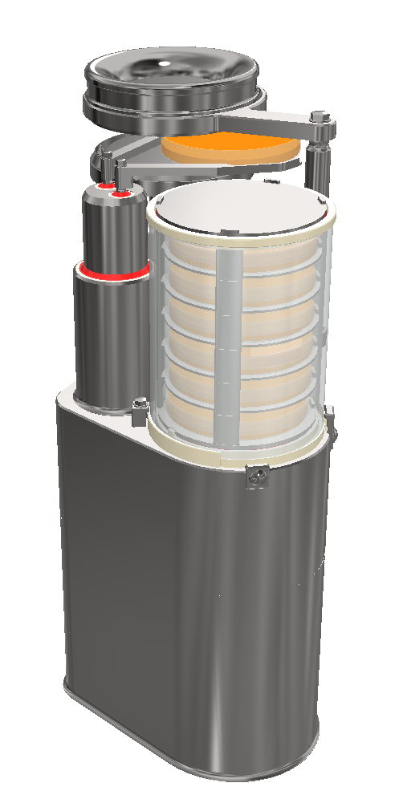
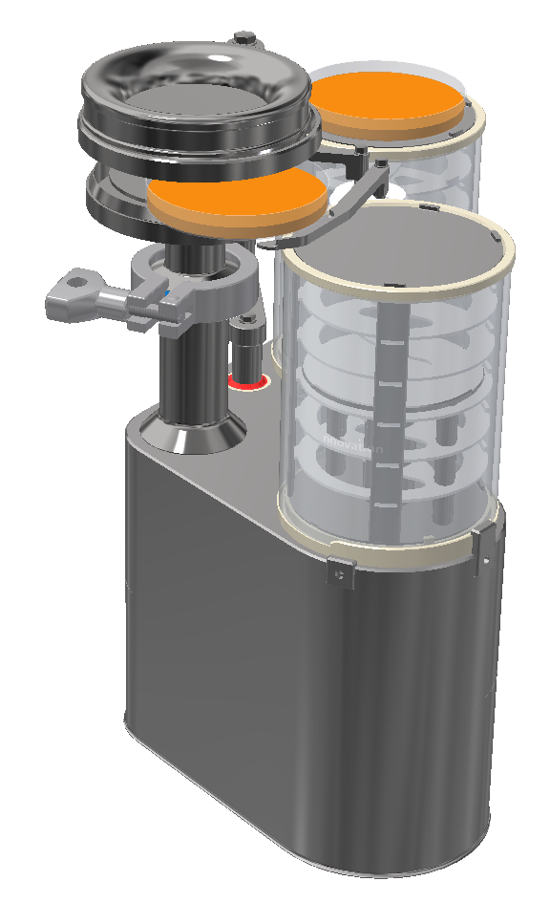
ENVIRONMENTAL MONITORING VIABLE MONITORING
AUTOMATED SETTLE PLATE CHANGER
  24 hours intervention free monitoring for a settle plate location
  Removes operator involvement
  Reduces chances of misplaced plates/lids
  6 intervention free samples for an active air sampler
  Can be combined with active air sampler
  Can be added as an option to roboFIL™
roboFIL™ incorporates an automated plate management solution for operator free loading and unloading of settle plates

Slide 16
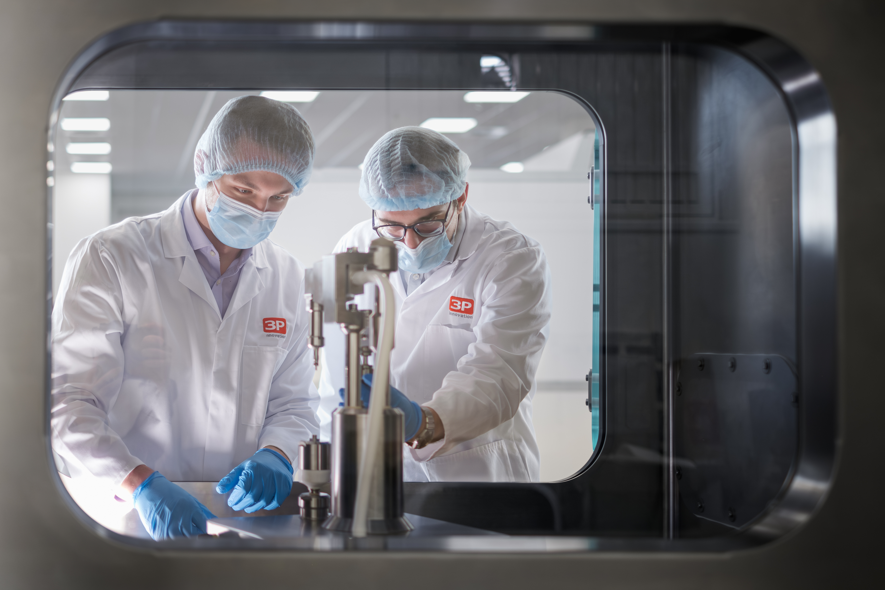
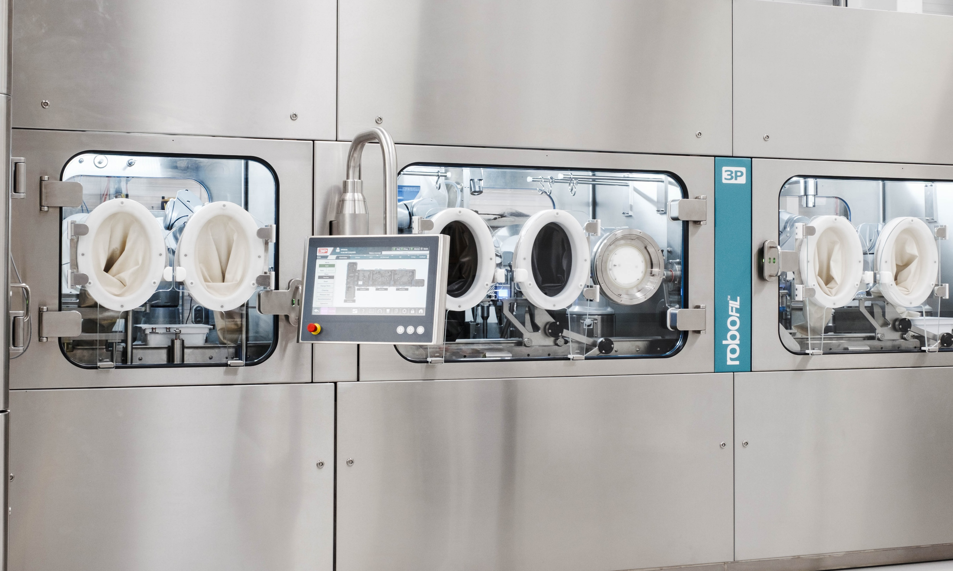

3P INNOVATION
CASE STUDY
ASEPTIC POWDER FILL FINISH LINE
  Multiple vial sizes: 2R (2ml) to 20R (20ml)
  Powder filling different powders
  Single Head F2W System (R1)
  Fill weights up to 1g
  Speed 5/min
CASE STUDY

Slide 17



Telephone
+44 (0) 1926 408933
Address
THANK YOU
3P innovation (HQ)
Tournament Fields, Bosworth Avenue, Warwickshire, United Kingdom,
CV34 6UQ
Website
www.3Pinnovation.com

